Slide 1
Betweenness centrality

Slide 2
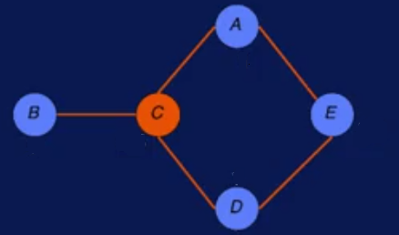
Centrality Analysis
We call something central if it's in the middle of a larger entity.
We also call something central if it's important and vital.
For graphs, we'll identify important nodes by looking at how central they are.
Look at the six node graph, you don't have to know a lot to figure out that the orange node is pretty important
One reason could be it's the most vulnerable node. If you remove it the graph will fall apart. This is clearly one way to look at the centrality of the node.

Slide 3
Centrality Analysis
Another way of looking at the orange node, is that it can reach all other nodes quicker, than any other node.
So this is the idea behind influences.
People in a social network who are connected enough to reach out and possibly influence a lot more people than others will be able to.
If the little graph represents a transportation network. And you were asked to build a restaurant somewhere around this network. You'll possibly choose an area near the central node.
Because more traffic will flow through this node than other nodes.

Slide 4
Centrality Analysis
We have a network and we are trying to find a small subset of people who's removal will maximally disrupt the network. The key operative word here is maximally.
So if there is a node which removal breaks the network into two parts, it is not what we want if there's another two nodes whose removal will break the network into ten parts.
The goal is to find a small set of nodes with maximal combined reachability to other nodes. That means, taken together, these node should reach almost all other nodes.
we can compute the network centralization by considering the sum of the difference between the maximum centrality and the centrality of the node divided by the maximum centrality.

Slide 5
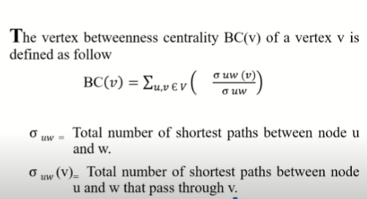
Betweenness centrality

Slide 6
Example 1
Let us consider a graph shown below:
In order to find the betweenness centrality of a node in a graph,
Find the shortest paths between every pair of vertices, let this be A
Next, Find the number of paths in which the particular node is between these shortest paths, let this be B.
Divide B/A for every pair of shortest paths.
Add all the non-zero (B/A) and this gives
the betweenness centrality.

Slide 7
For Node A,
(A,B) = NA ( A happens to be the end-node)
(A,C) = NA ( A happens to be the end-node)
(A,D) = NA ( A happens to be the end-node)
(A,E) = NA ( A happens to be the end-node)
(B,C) = 0/1
(B,D) = 0/1
(B,E) = ½ = 0.5 ( two paths BCAE, BCDE)
(C,D) = 0/1
(C,E) = ½ = 0.5 ( two paths CAE, CDE)
(D,E) = 0/1
Betweenness Centrality of A is 0.5+ 0.5 =1

Slide 8
For Node B, the betweenness centrality is zero. Since it is not included as an intermediate node in any of the shortest path between various pairs of vertices.
For the node C, the betweenness centrality calculation
(A,B) = No. of Shortest path between A and B is 1 (A)
No. of shortest path between A and B, containing C as intermediate node is 1 (B)
= B/A = 1/1 = 1
(A,C) = NA (Since C is the ending node, for calculating the degree centrality of a particular node, that particular node should never be a end vertex)
(A,D) = ½ = 0.5
(A,E) = 0/1
(B,C) = NA ( C is the ending node)
(B,D) = 1/1 =1
(B,E) =2/2 =1
(D,E) = 0/1 Betweenness centrality of C = 1+0.5+1+1 = 3.5

Slide 9
For Node D,
(A,B) = 0/1
(A,C) = 0/1
(A,D) = NA ( D happens to be the end-node)
(A,E) = 0/1
(B,C) = 0/1
(B,D) = NA ( D happens to be the end-node)
(B,E) = ½ = 0.5 ( Two paths BCAE, BCDE)
(C,D) = 0/1
(C,E) = ½ = 0.5 ( Two paths CAE, CDE)
(D,E) = NA ( D happens to be the end-node)
Betweenness Centrality of D is 0.5+ 0.5 =1

Slide 10
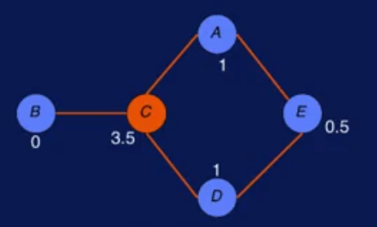
For Node E,
(A,B) = 0/1
(A,C) = 0/1
(A,D) = ½ = 0.5 (two paths AED, ACD)
(A,E) = NA ( E happens to be the end-node)
(B,C) = 0/1
(B,D) = 0/1
(B,E) = NA ( E happens to be the end-node)
(C,D) = 0/1
(C,E) = NA ( E happens to be the end-node)
(D,E) = NA ( E happens to be the end-node)
Betweenness Centrality of E is 0.5

Slide 11
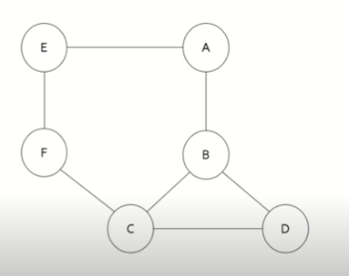
Example 2
Let us find the betweenness centrality of the nodes for the graph shown below.

Slide 12
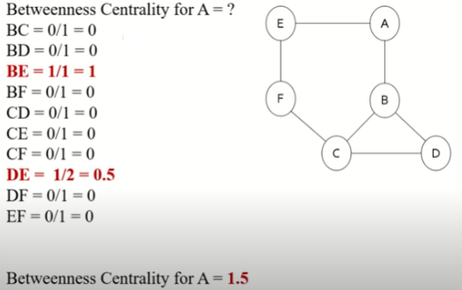

Slide 13
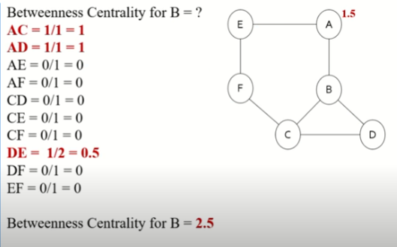

Slide 14
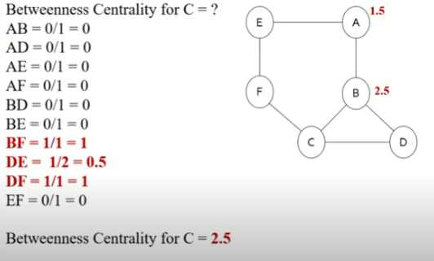

Slide 15
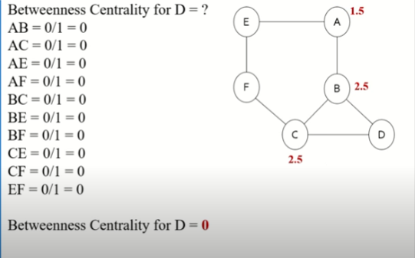

Slide 16
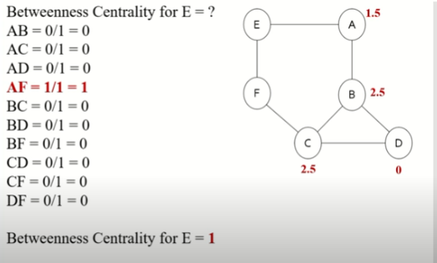

Slide 17
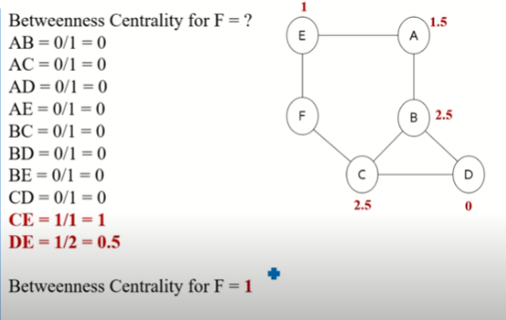

Slide 18
Thank you

